Slide 1
State Machine Diagram
UML Behavioral diagram

Slide 2
State Machine Diagrams
State machine diagram is a behavior diagram which shows discrete behavior of a part of designed system through finite state transitions.
Two kinds of state machines defined in UML 2.4 are
behavioral state machine
protocol state machine.
The following nodes and edges are typically drawn in state machine diagram:
behavioral state,
behavioral transition,
protocol state,
protocol transition,
different pseudostates.

Slide 3
Behavioral State Machine
Behavior is modeled as a traversal of a graph of state nodes connected with transitions. These transitions are triggered by the dispatching of events.
Example: Think of a traffic light. It can be in states like "Green," "Yellow," or "Red." Transitions occur when it changes from one state to another based on events like a timer or a pedestrian crossing button.
The behavioral state machine can be owned by a behaviored classifier, known as its context. The context defines signal and call triggers, attributes, and operations available in the state machine.
Example: Consider a thermostat as a behaviored classifier. The behavioral state machine it owns might represent states like "Heating," "Cooling," or "Idle," triggered by events like "Temperature Change."
The state machine may be associated with a behavioral feature (method) and specifies the behavior of this feature.
Example: Imagine a vending machine. The behavioral state machine associated with the "Dispenser" feature may have states like "Ready," "Dispensing," and "Empty," triggered by events like "Product Selected."
The event pool for the state machine is linked to the event pool of the instance according to the behaviored context classifier or the classifier owning the behavioral feature.
Example: In an elevator system, the event pool for the state machine includes events like "Button Pressed" or "Floor Reached," affecting transitions between states like "Moving" or "Stopped."

Slide 4
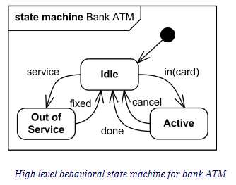
Behavioral State Machine

Slide 5
Vertex
Vertex is named element which is an abstraction of a node in a state machine graph.
Subclasses of vertex are:
state
pseudostate
State is a vertex which models a situation during which some (usually implicit) invariant condition holds.
Inherited states are drawn with dashed lines or gray-toned lines.
The UML defines the following kinds of states:
simple state,
composite state,
submachine state.
Notes:
Subclasses of vertex are:
state
pseudostate

Slide 6
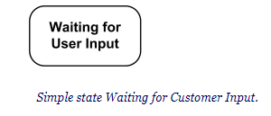
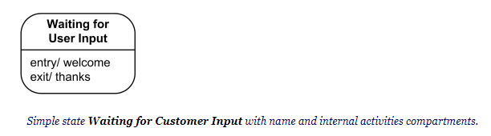
Simple State
A simple state is a state that does not have substates - it has no regions and it has no submachine states.
Simple state may have compartments. The compartments of the state are:
name compartment
internal activities compartment
internal transitions compartment
Name compartment holds the (optional) name of the state, as a string. States without names are called anonymous states and are all considered distinct (different) states.
Internal activities compartment holds a list of internal actions or state (do) activities (behaviors) that are performed while the element is in the state.
Internal transition compartment contains a list of internal transitions, where each item has the form as described for trigger. Each event name may appear more than once per state if the guard conditions are different.

Slide 7
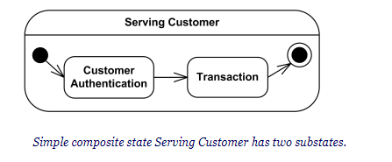
Composite State
Generally, composite state is defined as state that has substates (nested states).
Substates could be sequential (disjoint) or concurrent (orthogonal)
UML 2.4 defines composite state as the state which contains one or more regions.
Simple composite state contains just one region.
Orthogonal composite state has more than one regions. Each region has a set of mutually exclusive disjoint subvertices and a set of transitions
A region is defined in UML 2.4 as an orthogonal part of either a composite state or a state machine. Region contains states and transitions.

Slide 8
Pseudostate
A pseudostate is an abstract vertex that encompasses different types of transient vertices in the state machine graph.
Pseudostates include:
initial pseudostate
terminate pseudostate
entry point
exit point
choice
join
fork
junction
shallow history pseudostate
deep history pseudostate

Slide 9


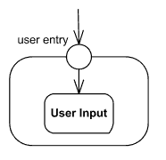
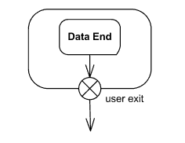
An initial pseudostate represents a default vertex that is the source for a single transition to the default state of a composite state
Terminate pseudostate implies that the execution of this state machine by means of its context object is terminated.
Entry point pseudostate is an entry point of a state machine or composite state. In each region of the state machine or composite state it has at most a single transition to a vertex within the same region.
Exit point pseudostate is an exit point of a state machine or composite state. Entering an exit point within any region of the composite state or state machine referenced by a submachine state implies the exit of this composite state or submachine state and the triggering of the transition that has this exit point as source in the state machine enclosing the submachine or composite state.

Slide 10
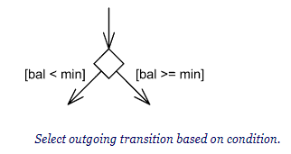
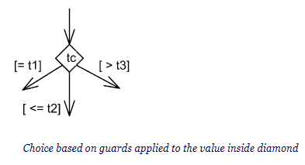
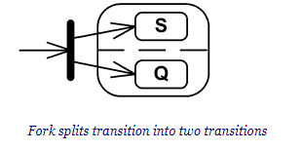
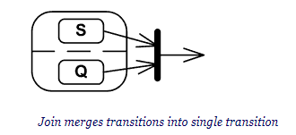


Slide 11
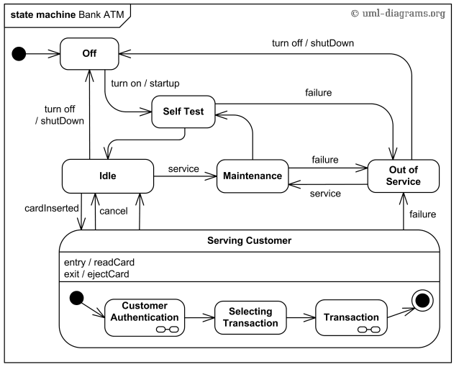

Slide 12
